Slide 1

Lecture 4-7 Classes and Objects

Slide 2
Contents
Introduction to Classes and Objects
Class declaration
Creating Objects
Accessing Object Members
Defining Member Functions
Nesting of Member Function
Access Specifiers: Public , Private
Nested Classes

Slide 3
Classes
Different from structures
Adds member functions
Not just member data
Integral to object-oriented programming
Focus on objects
Object: Contains data and operations
In C++, variables of class type are objects

Slide 4
Specifying a Class
A class is a way to bind the data and its associated functions together.
A class specification has 2 parts:
Class declaration
Class function definitions
Class declaration: describes type and scope of its members.
Class function definitions: describes how the class functions are implemented.

Slide 5
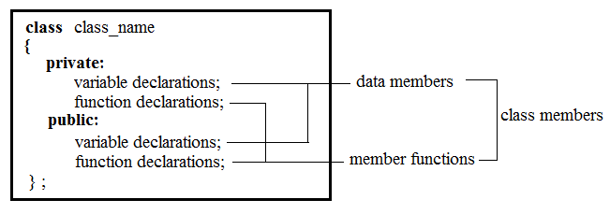
General form of Class declaration

Slide 6
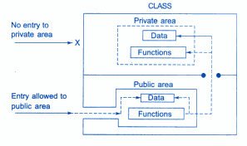
Data Hiding

Slide 7
Difference between Structure and Class
By default, members of class are private, while, by default, members of structure are public.
Encapsulation
The keywords public and private are known as visibility labels.

Slide 8
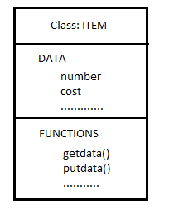
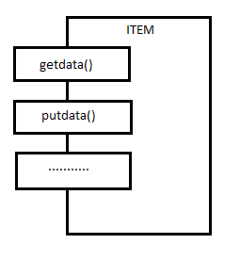
A Simple Class Example
class item
{
int number;
float cost;
public :
void getdata(int a, float b);
void putdata (void);
};
Class Representation
Creating Objects:
item x;
Accessing Class Members:
Object_name.function-name (actual-arguments);
x.getdata(100, 75.5); x.putdata( );

Slide 9
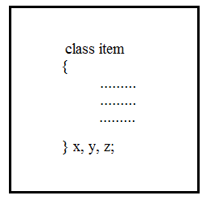
Creating Objects
Objects can also be created as follows:

Slide 10
Memory Allocation for Objects
Memory space for objects is allocated when they are declared and not when the class is specified : partially true.
Since all the objects belonging to that class use the same member functions, no separate space is allocated for member functions when the objects are created.
Only space for member variables is allocated separately for each object. Because, member variables will hold different data values for different objects.

Slide 11
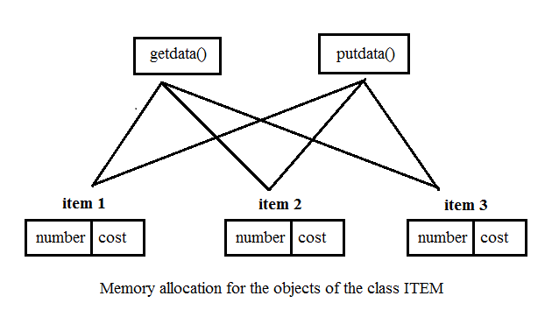
Example

Slide 12
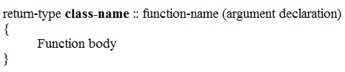
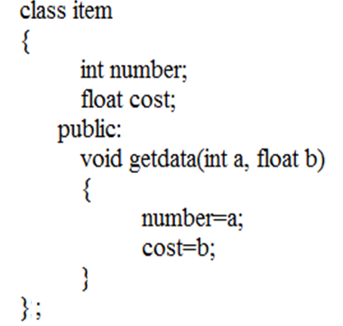
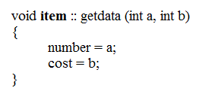
Defining Member Functions
Outside the class definition
When function is defined outside class, it requires a prototype declaration in the class.
Inside the class definition
When function is defined inside class, it does not require a prototype declaration in the class.

Slide 13
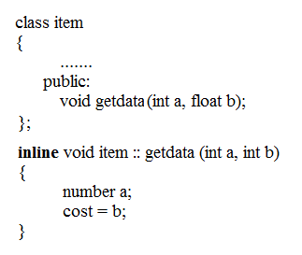
Inline Functions
We can define a member function outside the class definition and still make it inline by using the qualifier inline in the header line of the function definition.

Slide 14
Nesting of Member Functions
An object of a class using dot operator generally calls a member function of the class.
However, a member function may also be called by using its name inside another member function of the same class.
This is known as “Nesting of Member Functions”

Slide 15
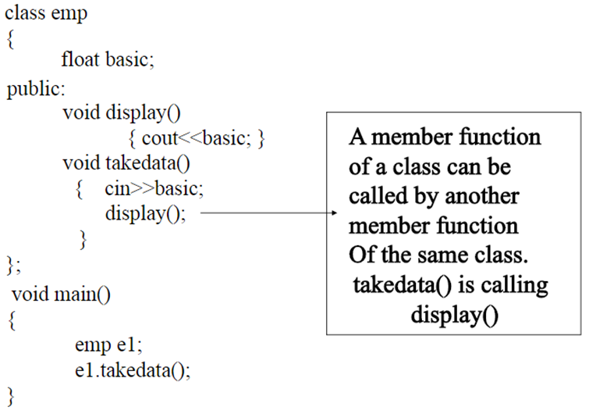
Nesting of Member Functions

Slide 16
Data Hiding Revisited

Slide 17
Access Specifier: Public
Public members are accessible outside the class.
Public members are accessible to both member Functions and non-member Functions.
Objects can access the members directly using dot operator. E.g.
object name.public data member
object name.public member function

Slide 18
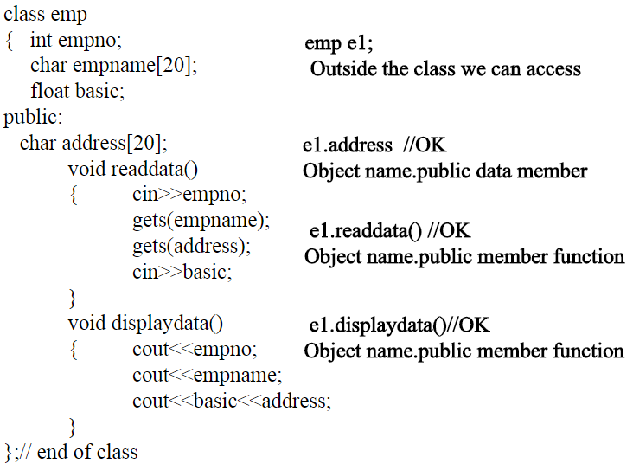
Access Specifier: Public

Slide 19
Access Specifier: Private
Private Members can only be accessed by the member functions of that class.
They cannot be accessed by any non member functions (data is hidden from outside world).
Object of a class cannot access private members using dot operators.
All data at the beginning of a class is by default private, until any specifier is mentioned.

Slide 20
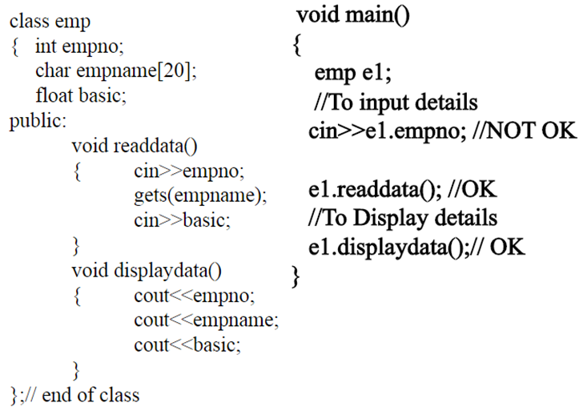
Access Specifier: Private

Slide 21
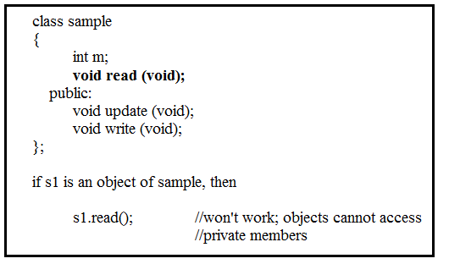
Private Member Functions

Slide 22
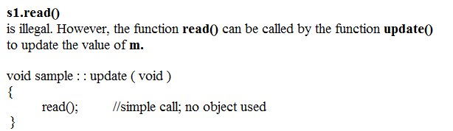
Private Member Functions

Slide 23
Nested Classes
A class is declared within another class.
The outer class is called enclosing class and inner class is called the nested class.
A nested class is a member and as such has the same access rights as any other member.
The members of an enclosing class have no special access to members of a nested class; the usual access rules shall be obeyed.

Slide 24
Nested Classes Example
#include<iostream>
using namespace std;
class Enclosing /* start of Enclosing class declaration */
{
int x;
class Nested
{ /* start of Nested class declaration */
int y;
void NestedFun(Enclosing e)
{
cout<<e.x; // works fine: nested class can access
// private members of Enclosing class
}
}; // declaration Nested class ends here
}; // declaration Enclosing class ends here
int main(){}

Slide 25
Nested Classes Example
#include<iostream>
using namespace std;
class Enclosing /* start of Enclosing class declaration */
{
int x;
class Nested
{ /* start of Nested class declaration */
int y;
}; // declaration Nested class ends here
void EnclosingFun(Nested n)
{
cout<<n.y; // Compiler Error: y is private in Nested }
}; // declaration Enclosing class ends here
int main(){}

Slide 26
Thank You

